Slide 1

CORONA VIRUS ANALYSIS USING SQL
BY,
MEGHA KERUR
PROFILE: DATA ANALYST INTERN
BATCH: MIP-DA-09

Slide 2

CONTENTS OF PROJECT
INTRODUCTION
OVERVIEW
QUERY PROBLEMS AND FINDINGS
CONCLUSION

Slide 3
INTRODUCTION
The coronavirus disease 2019 (COVID-19) pandemic is a global outbreak of coronavirus – an infectious disease caused by the severe acute respiratory syndrome coronavirus 2 (SARS-CoV-2).
The coronavirus pandemic has reshaped daily lives globally.
It has had a serious impact on public health and has created an urgent need for data-driven insights to understand the spread of the virus.
This analysis of coronavirus data using SQL aims to uncover key insights into it’s spreads and demographic impacts.
As a data analyst, you have been tasked with analyzing a CORONA VIRUS dataset to derive meaningful insights and present your findings.
Join us to explore critical aspects of the pandemic and understand it’s implications for decision-making and response strategies.

Slide 4
OVERVIEW
Here’s the synopsis of the key tasks we tackled:
Check for NULL values and update
Total number of rows
Start and End dates
Number of months present
Monthly averages of cases
Most frequent values by month
Minimum and maximum values per year
Total cases per month
Spread analysis with respect to Confirmed cases
Spread analysis with respect to Death cases
Spread analysis with respect to Recovered cases
Country-Level analysis
Top 5 countries with Highest Recovered cases.

Slide 5
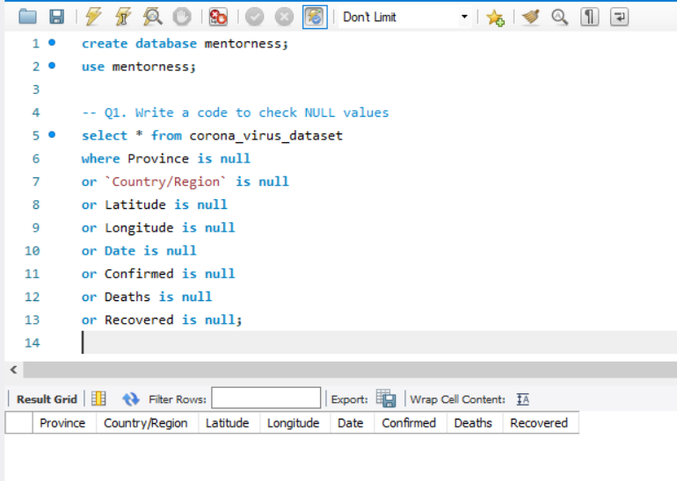
Write a code to check NULL values

Slide 6
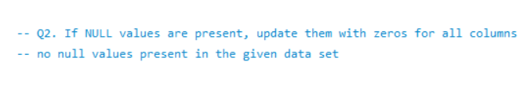
If NULL values are present, update them with zeroes for all columns

Slide 7
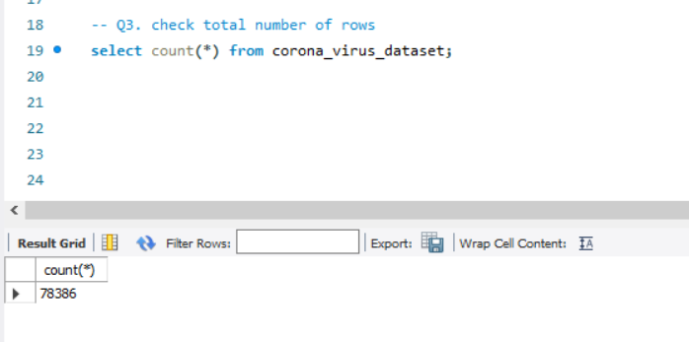
Check total number of rows

Slide 8
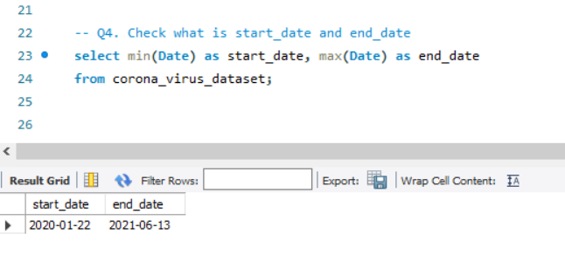
Check what is start date and end date of the pandemic

Slide 9
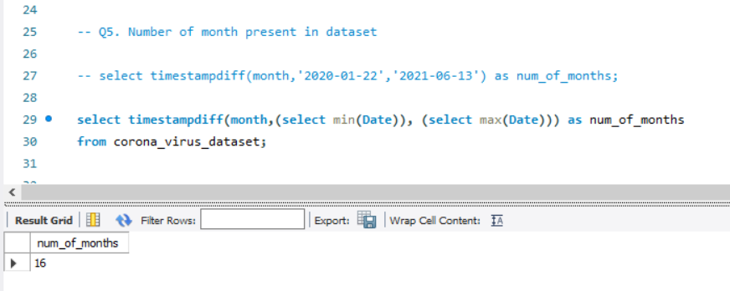
Number of months present in the dataset

Slide 10
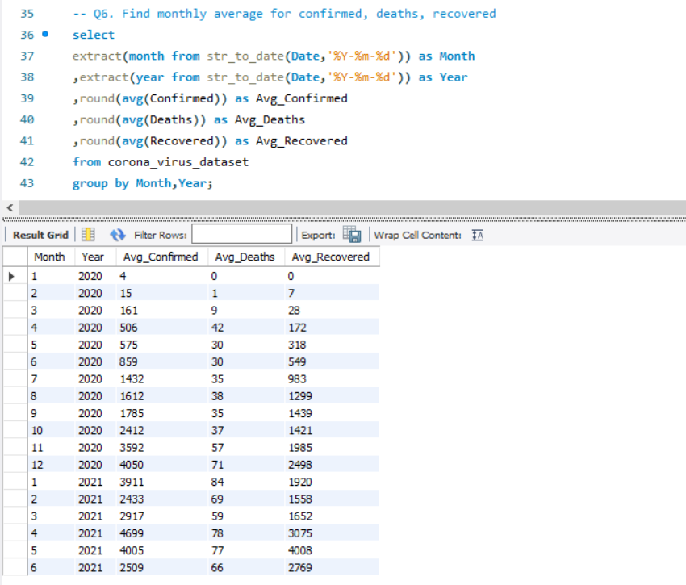
Find monthly average for Confirmed, Death & Recovered

Slide 11
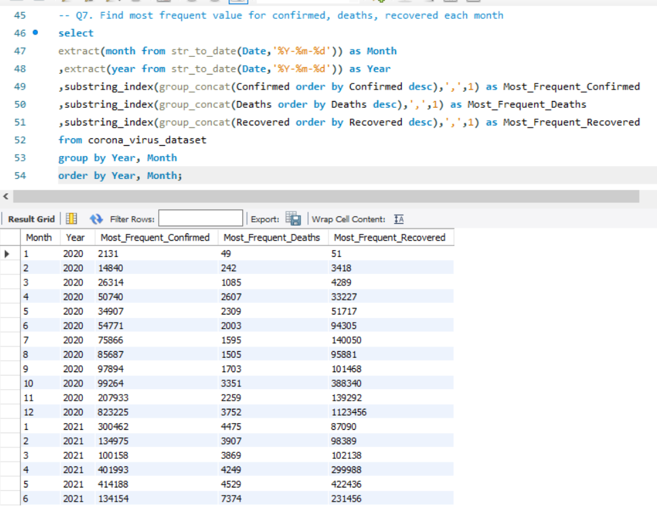
Find most frequent value for Confirmed, Death & Recovered

Slide 12
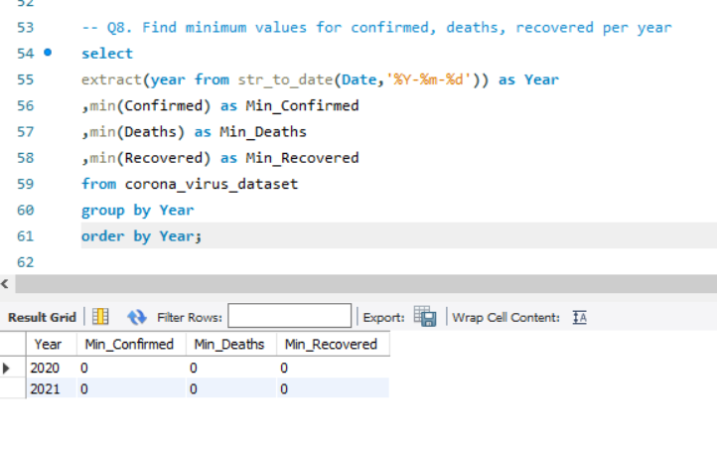
Find minimum values for Confirmed, Death & Recovered

Slide 13
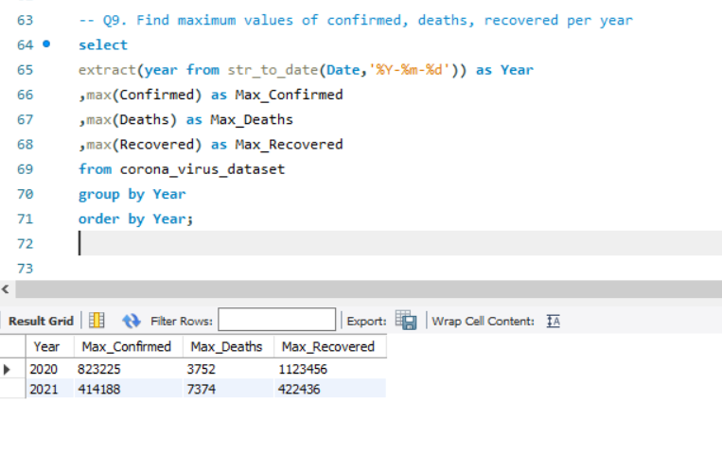
Find maximum values for Confirmed, Death & Recovered

Slide 14
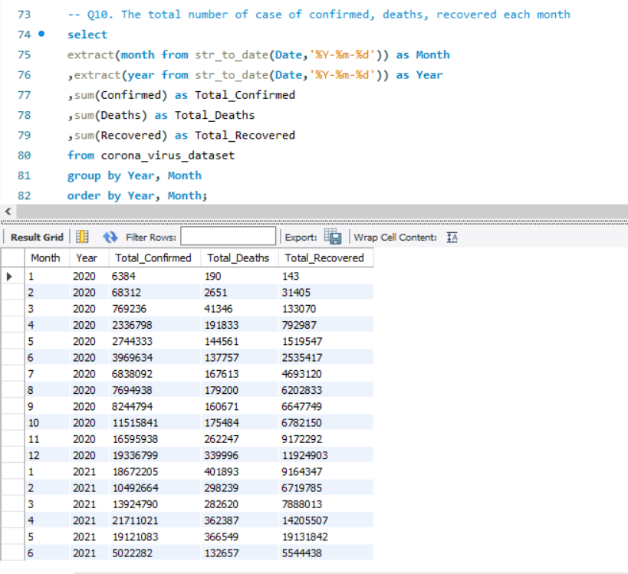
Total number of cases of Confirmed, Death & Recovered

Slide 15
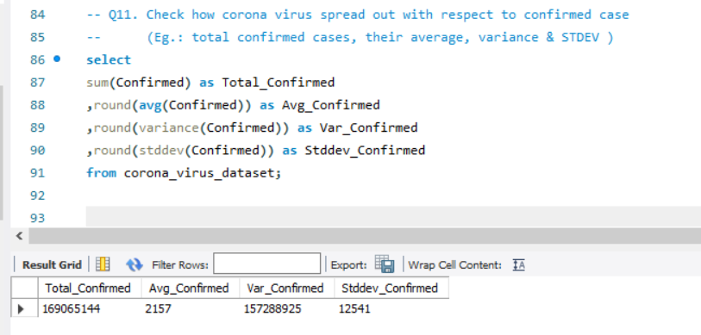
Check how corona virus spread out with respect to confirmed cases

Slide 16
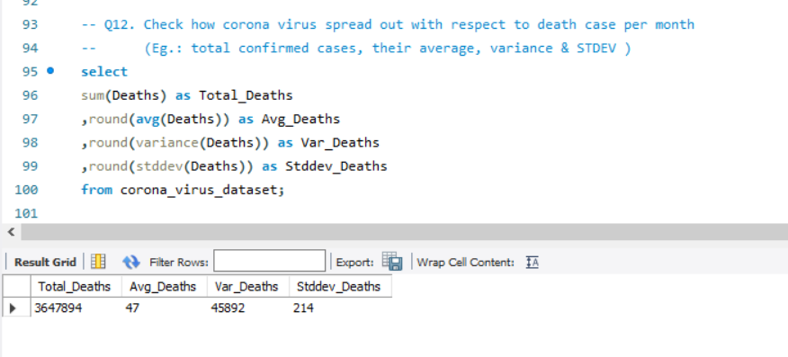
Check how corona virus spread out with respect to Death cases

Slide 17
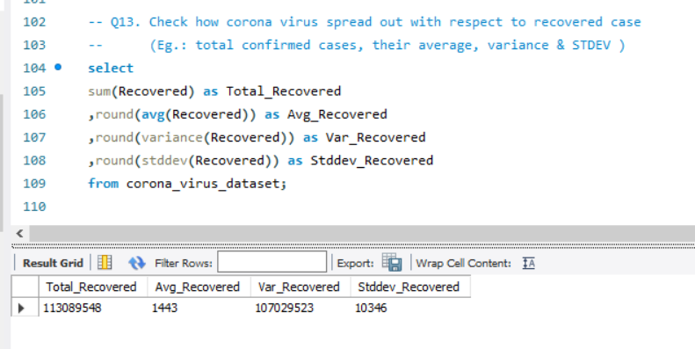
Check how corona virus spread out with respect to Recovered cases

Slide 18
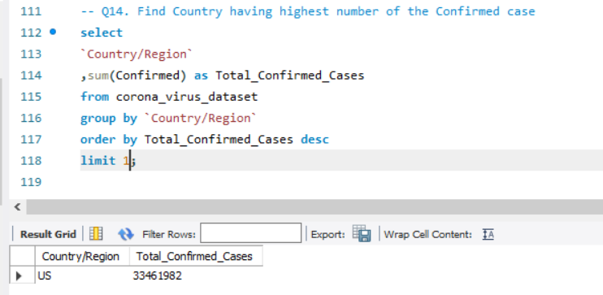
Find country having highest number of the Confirmed cases

Slide 19
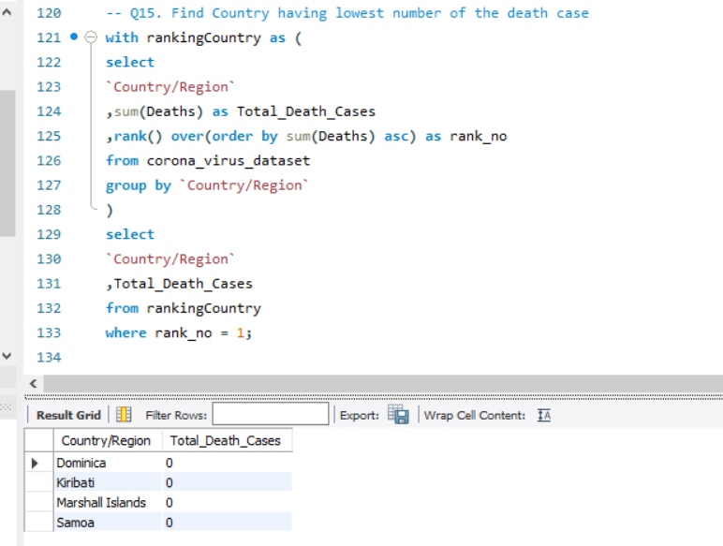
Find country having lowest number of the death cases

Slide 20
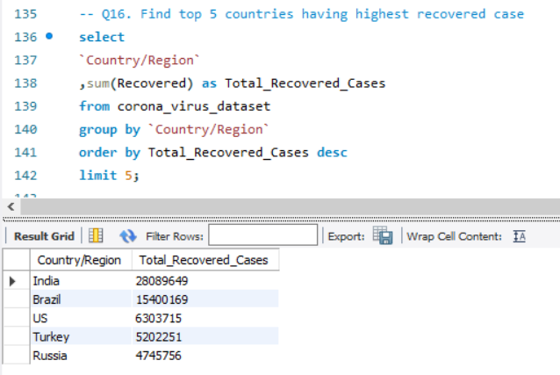
Find top 5 countries having highest recovered cases

Slide 21
CONCLUSION
The presentation aimed at providing insights into the pandemic’s trajectory, facilitate informed decision-making, and contribute to policy interventions in combating the global health crisis
The analysis also included the country-level analysis, identifying countries with the highest number of confirmed and recovered cases, as well as those with the lowest number of death cases.
The analysis journey delved into the intricate landscapes of the pandemic, leveraging SQL to extract valuable insights from the dataset.
The key tasks included checking for NULL values, determining the Row strength in data, identifying the span duration of data, calculating monthly averages for cases, analysing spread with respect to Confirmed, Death and Recovered cases, and conducting country-level cases.

Slide 22
THANK YOU

